Slide 1
Capstone Project
Bank Marketing Effectiveness Prediction
Ankush

Slide 2

DISCUSSION POINTS
Problem Description
Data summary
Eda
Dependant variable
Univariate
Bivariate
Correlation

Slide 3

DISCUSSION POINTS
Prepare Dataset for Modeling
Handel imbalance data
Outlier treatment
Model
Logistics Regression
Random Forest
KNN
SVC
LGBM
Conclusion

Slide 4
Problem Description
The data is related with direct marketing campaigns (phone calls) of a Portuguese banking institution. The marketing campaigns were based on phone calls. Often, more than one contact to the same client was required, in order to access if the product (bank term deposit) would be ('yes') or not ('no') subscribed. The classification goal is to predict if the client will subscribe a term deposit .

Slide 5
Data Summary
Age - Age of customer .
Job - type of job customers do.
Marital - Weather are customer is married, single or Divorced
Education - Qualification of our customer.
Default - Customer has credit in default or not.
Housing - Customers have a housing loan or not.
Loan - Customer has a personal loan or not.
Contact: contact communication type.
Month: last contact month of year.
day of week: last contact day of the week .

Slide 6
Data Summary
day of week: last contact day of the week .
Duration: last contact duration, in seconds.
Campaign: number of contacts performed during this campaign
Pdays: number of days that passed by after the client was last contacted from a previous campaign
Previous: number of contacts performed before this campaign and for this client
Poutcome: outcome of the previous marketing campaign
y : has the client subscribed a term deposit or not.

Slide 7
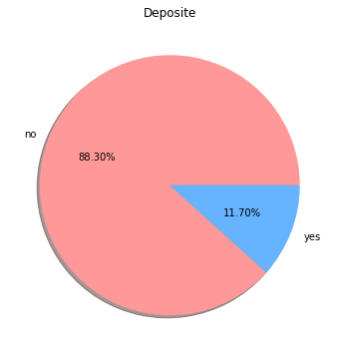
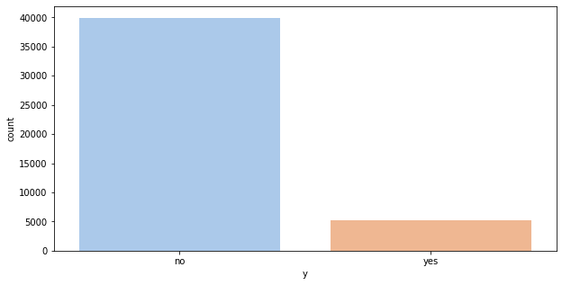
EDA (Dependant Variable)
Only 11.70% client subscribed term deposit

Slide 8
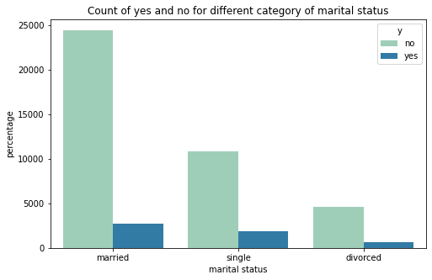
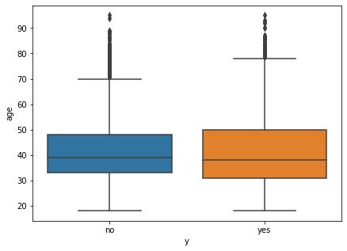
EDA (continue… )

Slide 9
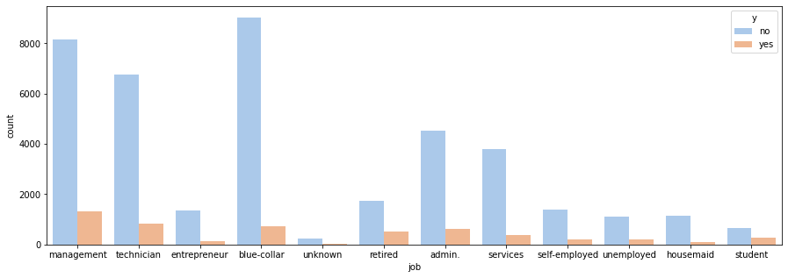
EDA (Continue…. )

Slide 10
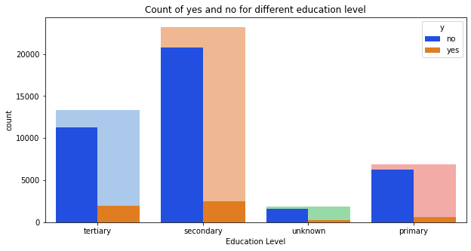
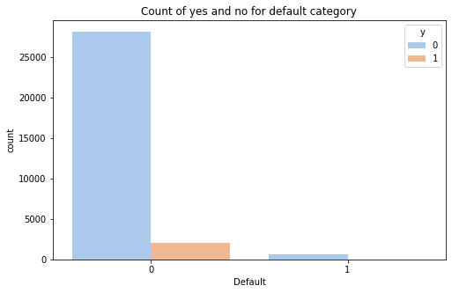
EDA (continue… )

Slide 11
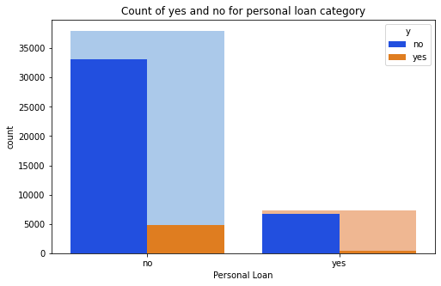
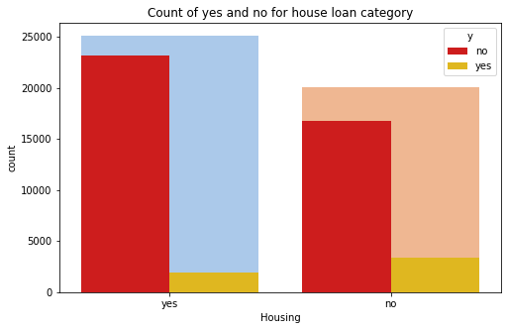
EDA (continue…. )

Slide 12
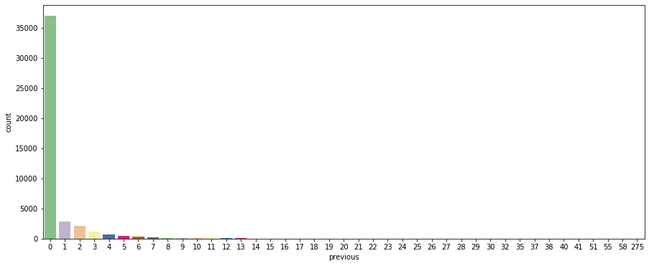
EDA (continue….)
We can see above that majority of people were not contacted previously before this campaign and there are no significant contacts after 11 times already done.

Slide 13
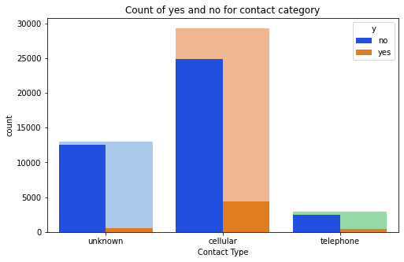
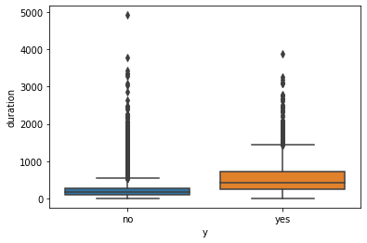
EDA (continue… )

Slide 14
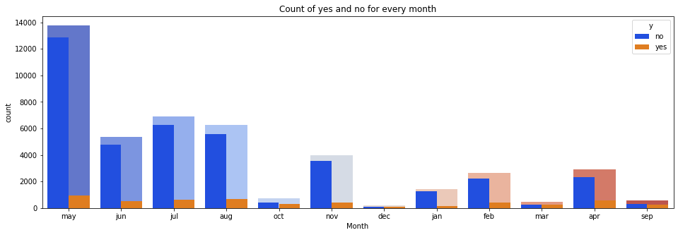
EDA (continue… )
There were maximum subscriptions in the month of may, june, july, and august.(Summer).

Slide 15
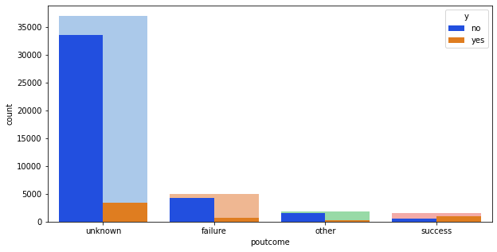
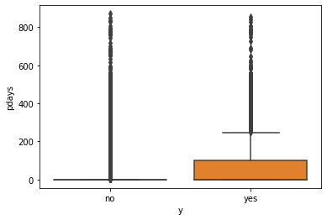
EDA (Continue….)

Slide 16
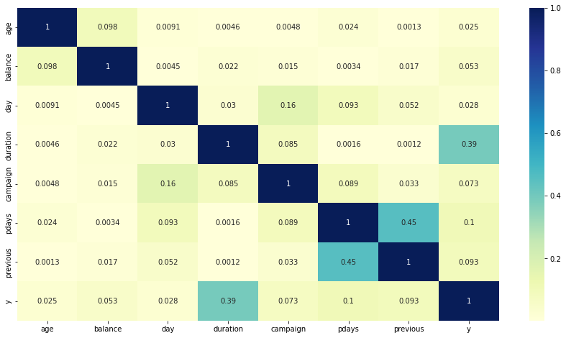
Correlation

Slide 17
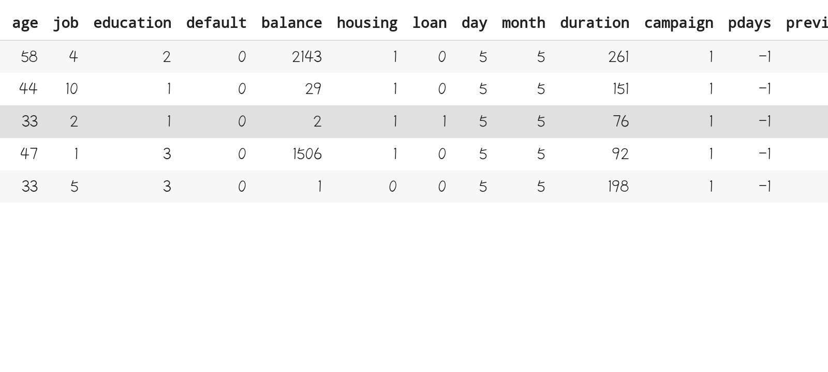

Preparing dataset For modeling
Task :-. Binary Classification
Train Set :- (50617, 14)
Test Set :- (21693, )

Slide 18

Creating Model
We create model of :
Logistics Regression
Random Forest
KNN
SVC
LGBM
LGBM (Hyper parameter Tuned)

Slide 19
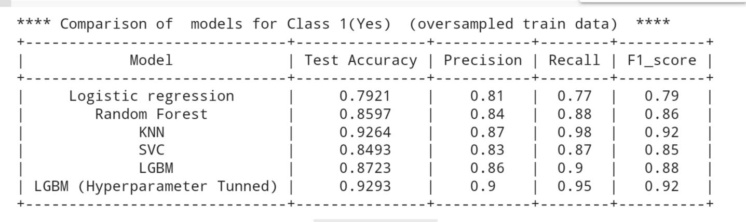
Model Selection

Slide 20
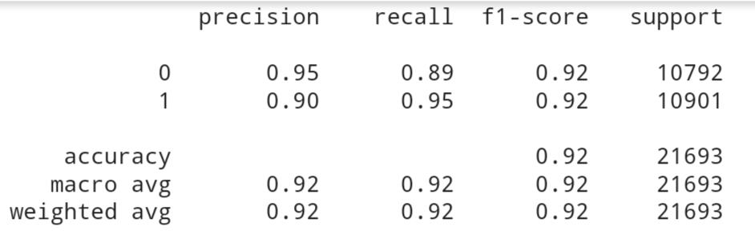
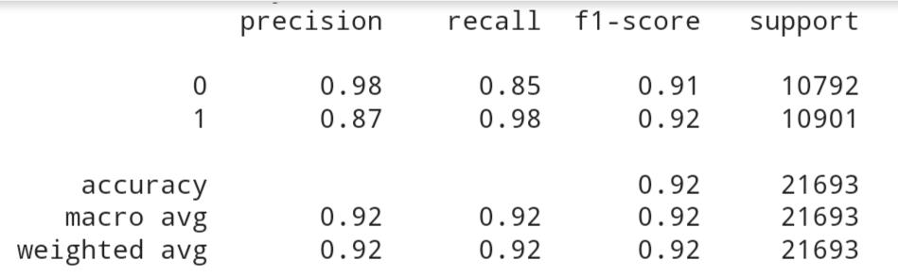
Model Validation and selection
Light GBM
KNN

Slide 21

Model Validation and selection
Observation : From the above observation we have come to the conclusion that we would choose our model from KNN or Light GBM as they are giving the best results.

Slide 22
Conclusion
Blue-collar, management and technician showed maximum interest in subscription.
Divorce people have no interest in term deposits.
People with secondary and tertiary education were more driven towards paying term deposits in banks.
Generally people who don't have credit in default are interested in a deposit.
Majority of the people have a home loan but only a few of them opted for a term deposit.
Cellular communication is more effective in comparison to other communication types.
There were maximum subscriptions in the Summer season.

Slide 23
Conclusion
The calls with large duration have more tendency for conversion.
People were mostly contacted only once.
Majority of people were not contacted previously before this campaign and there are no significant contacts after 11 times already done.
Success rate is high for unknown poutcome.
We can choose our model either Light GBM or KNN to predict Effectiveness as they both are showing best results.

Slide 24
Thank you

